Slide 1


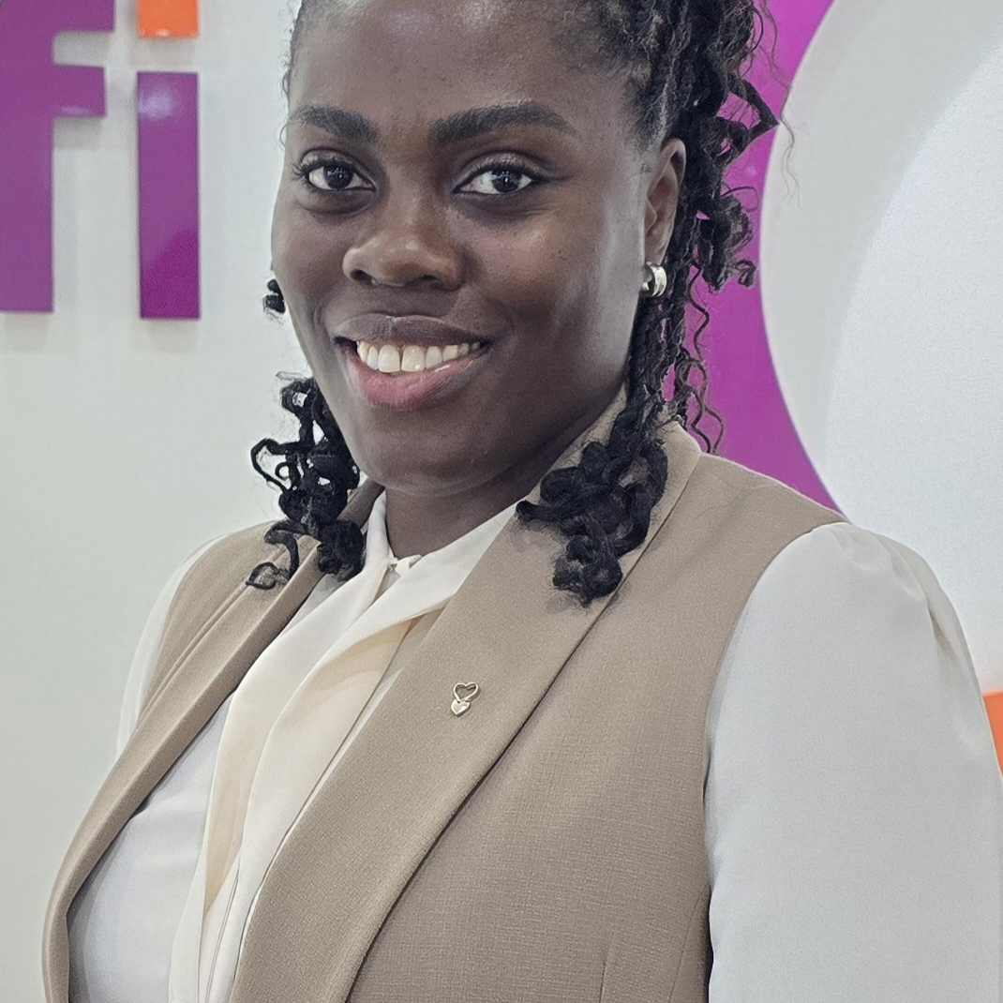
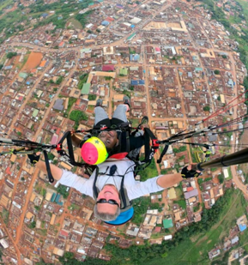
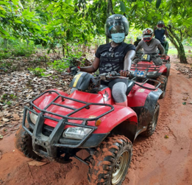
Getting to Know Me
Work
Personal
My role
Regional Learning & Development Manager - Africa
Significant others / family members / furry friends in my life
Husband & 2 sons
Tenure in ofi/Olam
1 month – Team Newbie ☺
How I enjoy spending my free time
Outdoors on an adventure or indoors reading writing or eating
Previous companies I have worked at
Open Development & Education, Nestlé, Codex Fortress Ghana
My favorite / comfort food
Anything warm, hearty & filling with a cross-country fusion twist
Why I joined ofi/Olam and what keeps me here?
ofi’s dynamic, people centered culture & entrepreneurial spirit - excited to be part of this amazing team
My favorite song
Song of the month: This is the Gospel – Elevation Rhythm
Mary Eshun
‘Just Mary’
A few fun facts about me
I grew up in the Kingdom of Eswatini. I occasionally moonlight as a voice actor, so you may have heard my voice on radio and television ads. I LOVE kele wele!
This is me outside work, doing stuff I enjoy in my life …

